Slide 1
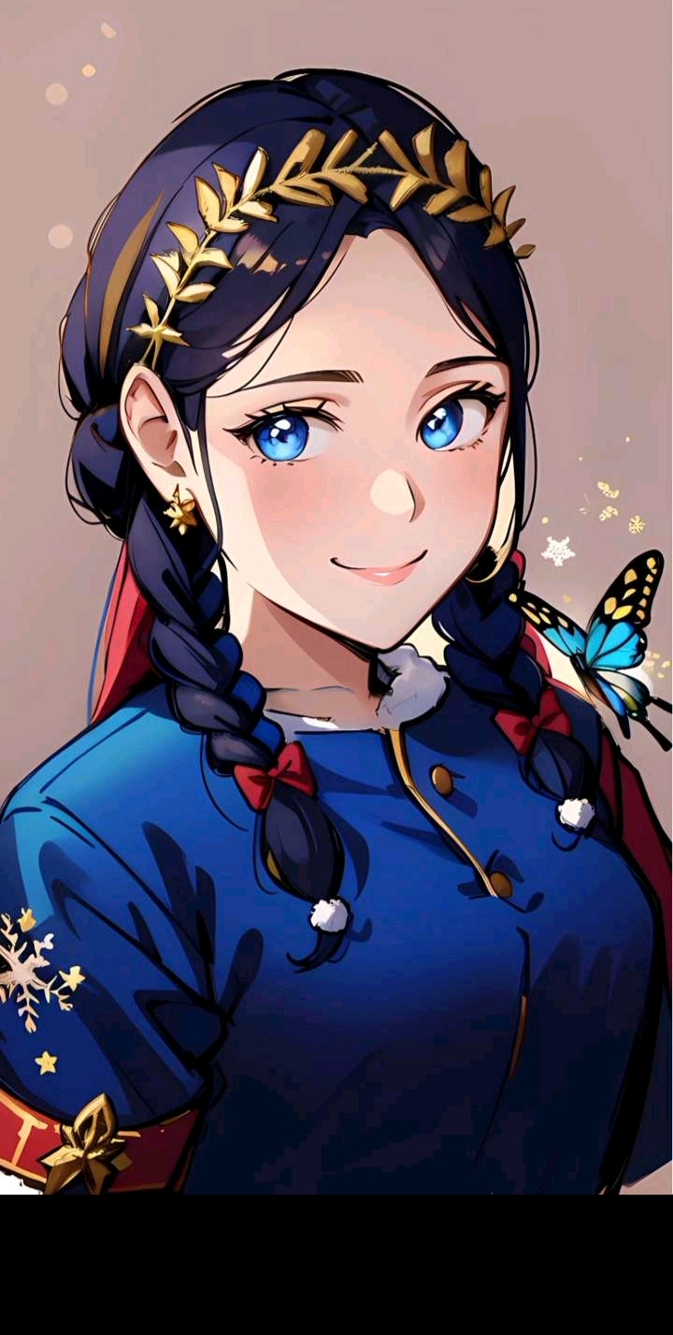
Digital Portfolio
STUDENT NAME: D.KRISHNA DEVI
REGISTER NO AND NMID: asanm10824131081802522039
DEPARTMENT: BSc.Computer Science
COLLEGE: TKGAC/Annamalai University

Slide 2

PROJECT TITLE
Creative My Portfolio using FWD

Slide 3


AGENDA
Problem Statement
Project Overview
End Users
Tools and Technologies
Portfolio design and Layout
Features and Functionality
Results and Screenshots
Conclusion
Github Link
3/21/2024 Annual Review

Slide 4

PROBLEM STATEMENT
The provided problem statement highlights that traditional assessment methods are insufficient in today's digital age because students need to demonstrate a wide range of digital literacy skills, such as technical proficiency, critical online research, media literacy, digital citizenship, and advanced problem-solving in online environments.

Slide 5

PROJECT OVERVIEW
The project's main idea is to build an online portfolio showcasing a personal brand by combining an "About Me" section, a gallery of completed projects, a list of developed skills, contact information, and visual elements like pictures to demonstrate your unique qualifications and expertise to potential clients or employers.

Slide 6



WHO ARE THE END USERS?
💫 Students
💫 Job seekers
💫 Professionals
💫 Software
💫 Educational institutons
💫 Employers

Slide 7

TOOLS AND TECHNIQUES
💫HTML-PAGES, SECTIONS
💫CSS-LAYOUT, COLORS, FONT
💫JAVASCRIPT-INTERACTIVE
NAVIGATION, FORM VALIDATION
💫VS CODE-IMPLEMENTATION CODE EDITOR, GITHUB CODEPEN

Slide 8
POTFOLIO DESIGN AND LAYOUT
💫 Section: Use sections to logically group and organize your portfolio's content for easy navigation.
💫 Home: A landing page that provides a brief introduction and overview of your portfolio.
💫 Projects: Showcase your best work through case studies, highlighting your skills and process.
💫 Skills: List and detail the abilities and expertise you possess relevant to your field.
💫 Contact: Provide clear and easy ways for visitors to reach you, such as an email or social media links.
💫 Mobile/Desktop/Tablet: Design your portfolio with a responsive layout that adapts seamlessly and functions well across all screen sizes and devices.
8

Slide 9

FEATURES AND FUNCTIONALITY
💫Navigation BAR with smooth scrolling
💫Image Details/Hyperlinks
💫Interactive elements-Animations, Hover efforts, background
💫Colour change
💫Contact Form validation
💫Responsive design for different devices

Slide 10
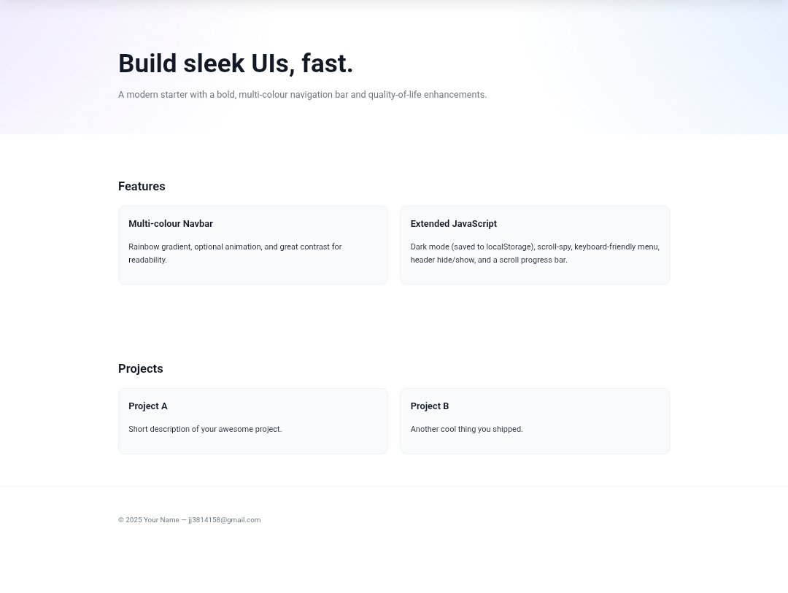

RESULTS AND SCREENSHOTS
3/21/2024 Annual Review
10

Slide 11

CONCLUSION
A portfolio conclusion, or metacognitive essay, should be a reflective summary of the entire portfolio's learning journey, highlighting growth as a learner, thinker, and writer, rather than just an essay summary.
11

